Slide 1
Using Moodle and TEAMs learning analytics to support EAP learners
CELE, U of Nottingham
Dr. Olga Burakov
Olga.Burakov@nottingham.ac.uk

Slide 2
Outline
1. Definition of learning analytics (LA) & a brief overview of the state of the field (e.g. Nottingham Trent University)
2. Using LA to support students: LA is not a neutral tool
LA as ‘a stick’: predictive & interventionist uses (Moodle)
LA as ‘a carrot’: adaptive learning (Moodle) & increasing student motivation (TEAMs)
3. Ethical considerations & implications

Slide 3
Learning analytics (LA)-a definition
LA can be defined as the measurement, collection, analysis and reporting of data about the progress of learners and the contexts in which learning takes place.
Examples: VLEs, Library services (E-book platforms recording student engagement)
(Dietz-Uhler and Hurn 2013; Sclater, Peasgood, and Mullan, 2016, Ifenthaler and Yin-Kim Yau, 2020)

Slide 4
The state of the field
-widely used in the US and Australia; credited with improving student retention rates (U of New England), identifying students at risk of failure (NY Institute of Technology, U of Maryland) and increasing student motivation (Purdue U, U of Michigan).
-relatively new in the UK: Nottingham Trent University’s ‘Dashboard’
-a university-wide project tracking student online engagement
-student- and staff-facing data visualisation platform or dashboard
‘Dashboard’ Results: No surprises/Some surprises
-strong link between online engagement and achievement (81% of students with a high average engagement graduated with a first)
-27% of students reported changing their study behaviour after using the system
-One third of tutors contacted students as a result of viewing their engagement data in the Dashboard
(Sclater, Peasgood, and Mullan, 2016, Sclater 2018, Ifenthaler and Yin-Kim Yau, 2020)

Slide 5
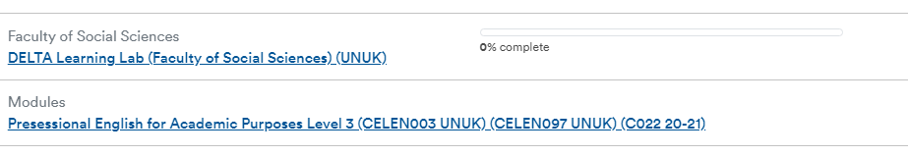
LA as ‘a stick’: predictive & interventionist uses
Tutors
-an early alarm (evidence-based) system
-identify students who are not engaging and may be therefore at risk
-student differentiation and monitoring of specific student groups (e.g. high or low IELTS targets)
Students
-can see own progress vs. peer progress & course/tutor expectations
-get/act on warnings/notifications
(Dietz-Uhler and Hurn 2013; Ifenthaler and Yin-Kim Yau, 2020)

Slide 6
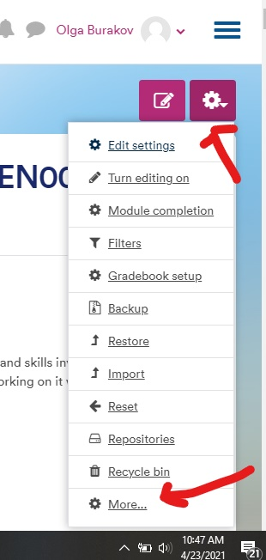
Moodle & LA functions

Slide 7
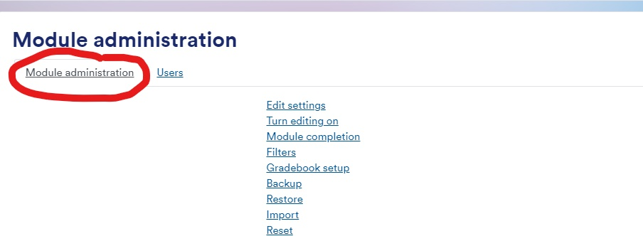
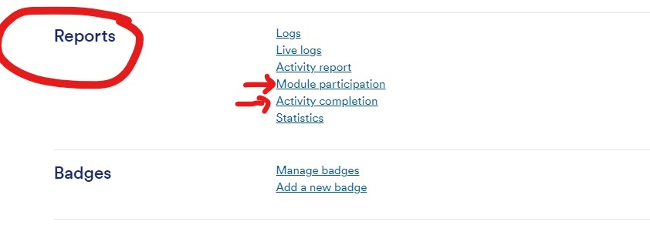
LA as ‘a stick’: predictive & interventionist uses

Slide 8
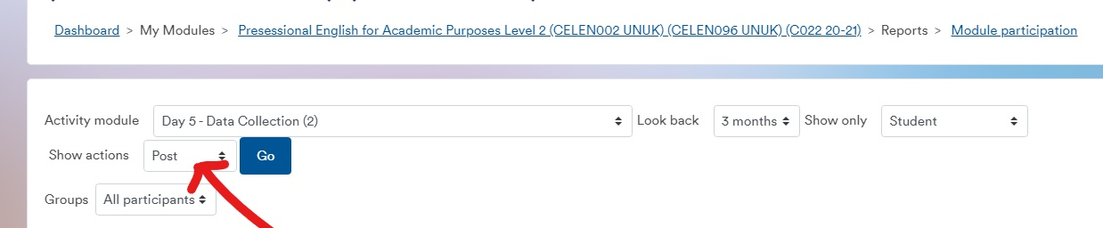
LA as ‘a stick’: predictive & interventionist uses
Module participation-focus on forum posts (who posted, how many times)

Slide 9
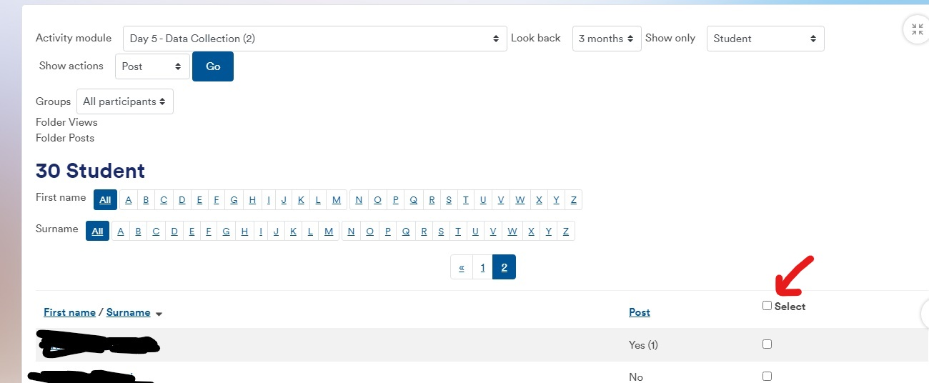



LA as ‘a stick’: predictive & interventionist uses
Module participation-focus on discussion forum posts

Slide 10
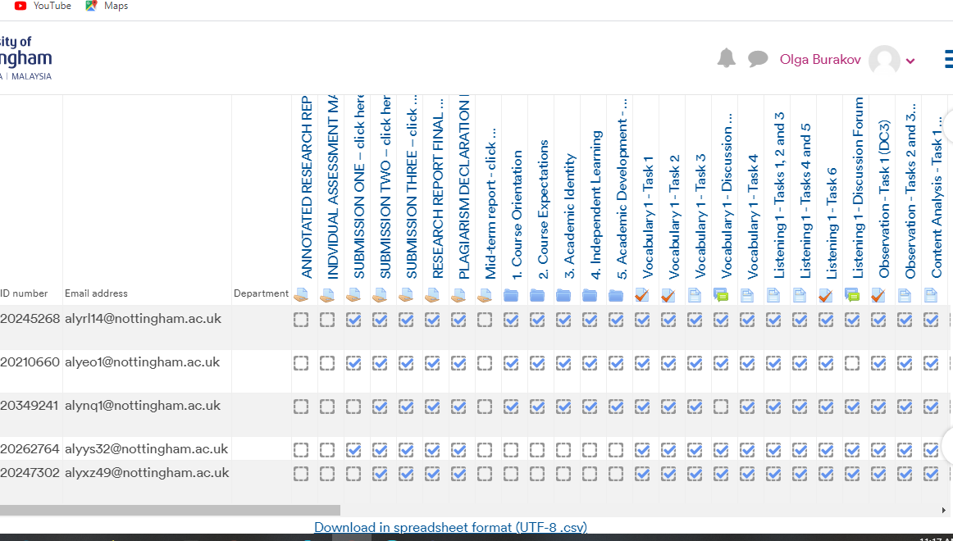





LA as ‘a stick’: predictive & interventionist uses
Activity completion

Slide 11
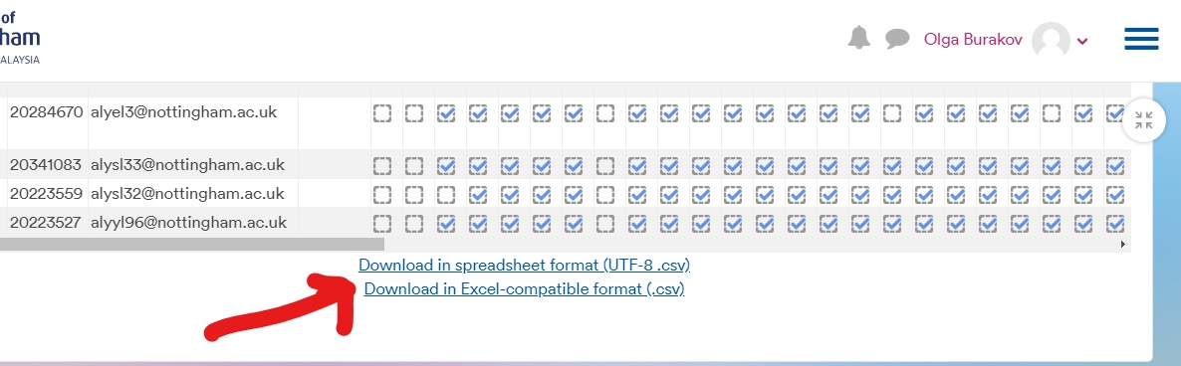




LA as ‘a stick’: predictive & interventionist uses
Activity completion

Slide 12
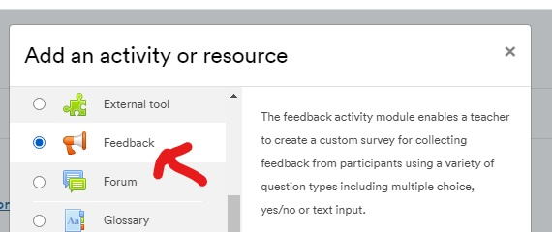
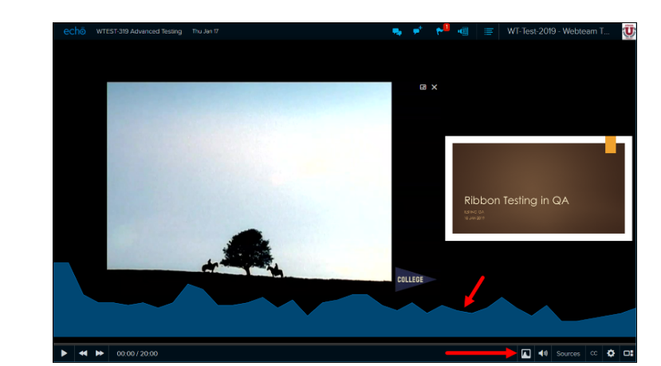
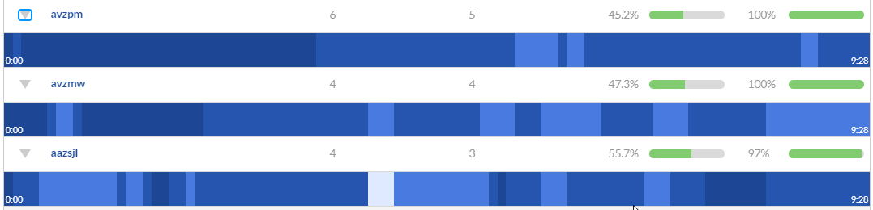
LA as ‘a carrot’: adaptive learning
Tutors
-Tracking engagement trends to see how materials/tasks/videos are used to improve them: feedback activities & video ‘heat maps’
Students
-Tracking engagement to identify strengths and weaknesses through feedback activities and reflect on progress
(Dietz-Uhler and Hurn 2013; Selwyn, 2019, Ifenthaler, D and Yin-Kim Yau J., 2020)

Slide 13
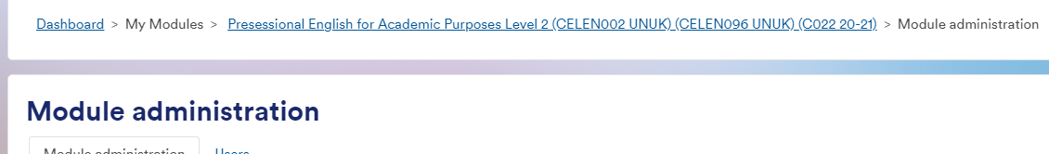
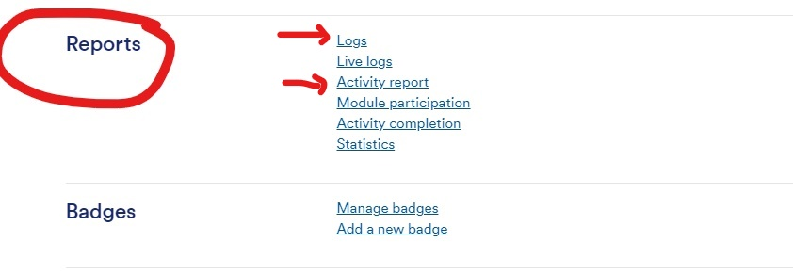
LA as ‘a carrot’: adaptive learning

Slide 14
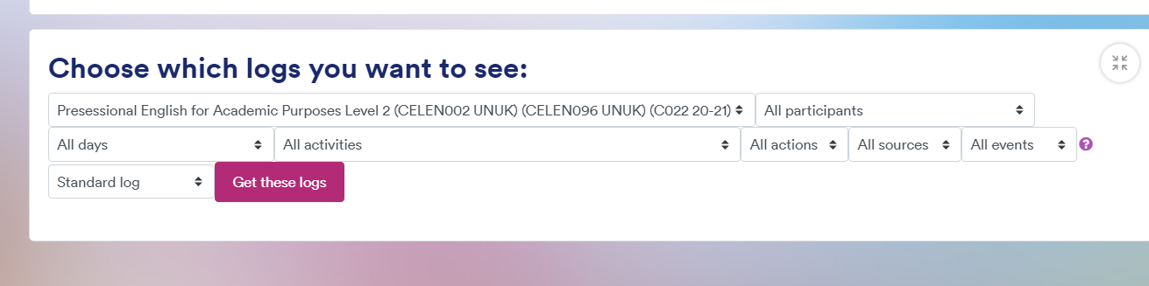
LA as ‘a carrot’: adaptive learning
Logs for individual students and tasks

Slide 15
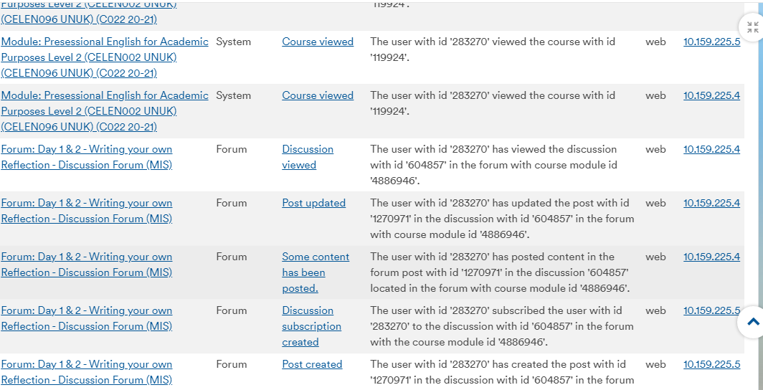










LA as ‘a carrot’: adaptive learning
Logs for individual students and tasks

Slide 16
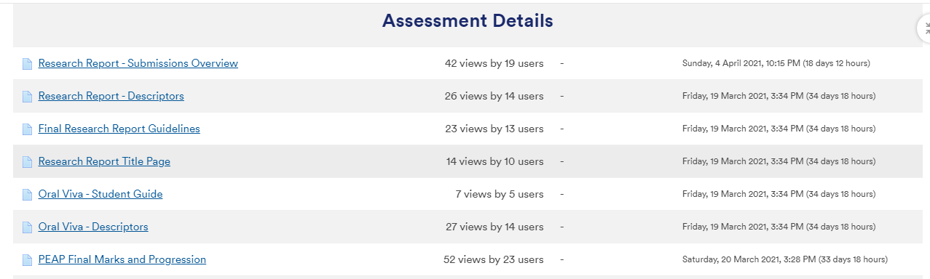
LA as ‘a carrot’: adaptive learning
Activity report

Slide 17
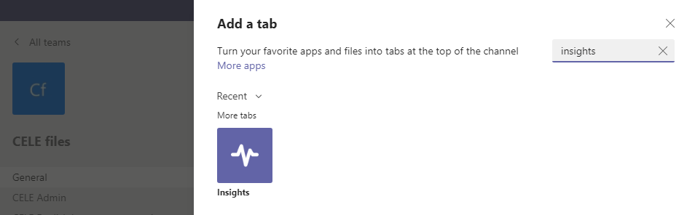
LA as ‘a carrot’: increasing student motivation
TEAMs Insights
An app that can be added to a TEAM as a tab, will surface and make visible activity data from all channels within a class team, but can only be added as a tab to public channels (e.g. General channel)
For more info on how to do this: https://www.youtube.com/watch?v=zsrx_JjXVgU

Slide 18
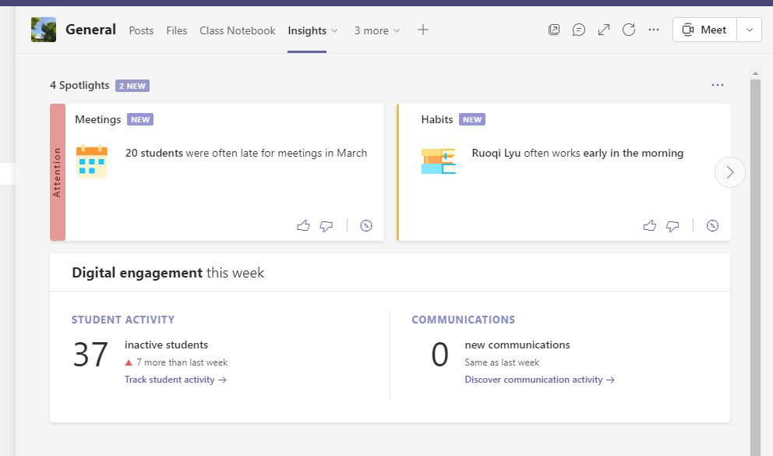

LA as ‘a carrot’: increasing student motivation
Insights’ tab makes student digital engagement visible and can help them with time-management issues (e.g. study habits, meeting attendance)

Slide 19
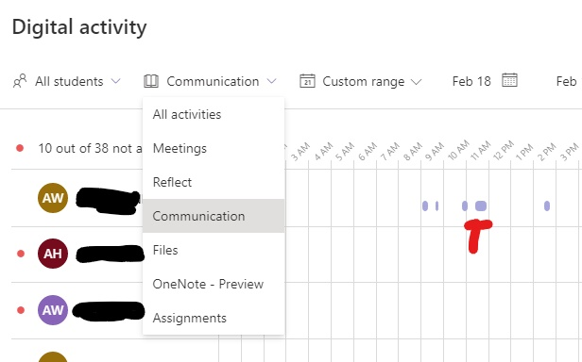
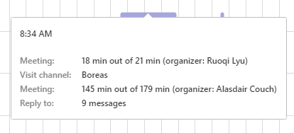


LA as ‘a carrot’: increasing student motivation
-shows student communication engagement (e.g. channel posts) and their ‘social network’

Slide 20
Ethical considerations & implications
-Need for transparency and consent: LA not just tutor-facing but student-facing & clarity about what we are measuring and why
-Privacy concerns to do with use/storage of/ access to data (Big Brother HE?)
-Need to be critical: use of LA to benefit & support students and not only as a ‘deficit model’/ a surveillance ‘stick’
-Need to minimise LA’s possible adverse effects: e.g. LA can never give a complete picture of a student (Sclater, 2018); can create a self-fulfilling prophecy (Dietz-Uhler and Hurn 2013); can make students perform ‘to game the system’ (Selwyn 2019)

Slide 21
References
Dietz-Uhler, B. and Hurn J. (2013). ‘Using learning analytics
to predict (and improve) student success’. Journal of interactive online learning 12.1. 17-26.
Ifenthaler, D and Yin-Kim Yau J., (2020). ‘Utilizing learning analytics to support study success in higher education: a systematic review’. Education Tech Research Dev 68: 1961-1990.
Sclater, N, Peasgood A. and Mullan, J. (2018). ‘Learning analytics in HE: a review of UK and international practice.’ JISC report. Available online https://www.jisc.ac.uk/reports/learning-analytics-in-higher-education [April 25, 2021]
Sclater, N. (2018). Code of practice for learning analytics. JISC. Available online https://www.jisc.ac.uk/guides/code-of-practice-for-learning-analytics [April, 19, 2021]
Selwyn, N. (2019) ‘What’s the problem with learning analytics?’ Journal of learning analytics [online] 6(3), 11–19. Available from < https://learning-analytics.info/index.php/JLA/article/view/6386/7308> [May 6th, 2021]
Wong, B. (2017). ‘Learning analytics in higher education: an analysis of case studies’. Asian Association of Open Universities Journal 12.1. 21-40.
Whitehead, H. Faculty of Social Sciences’ Digital Demos and DELTA Learning Lab, U of Nottingham, 2021.

