Slide 1
Online Pedagogy: Building Learning Communities
Kerith George-Briant & Janie Brooks
EAP in the North
01 May 2020

Slide 2
Overview
Online teaching & learning
Building learning communities
Tentative conclusions

Slide 3
Online teaching
"...it [emergency remote teaching] is a way of thinking about delivery modes, methods, and media, specifically as they map to rapidly changing needs and limitations in resources, such as faculty support and training."
Hodges et al. (2020)
"Trying to make an online class function exactly like an on-ground class is a missed opportunity. There’s a lot that happens in F2F classrooms that just can’t be replicated in an online environment, and that’s okay. Better to ask ourselves what can be achieved online and what sorts of classes (or learning experiences) we can construct to leverage the potentials of the specific interface or community."
Morris & Stommel (2018)

Slide 4
Advantages of online education
ubiquity
personalization
reduced costs
flexibility
increase in overall comfort
time saving
convenience
Aithal & Aithal (2016)

Slide 5
What is a classroom?
Teachnowaug15c2, (n.d.)

Slide 6
Community persona
How to explore concepts and communicate complex ideas between zones, locations and spaces?
How to transition between educational cultures, settings and level of study?
How to personalise the learning experience?

Slide 7
Supporting forum interaction
"...careful planning for online learning includes not just identifying the content to cover but also carefully tending to how you're going to support different types of interactions that are important to the learning process. This approach recognizes learning as both a social and a cognitive process, not merely a matter of information transmission."
Hodges et al. (2020)

Slide 8
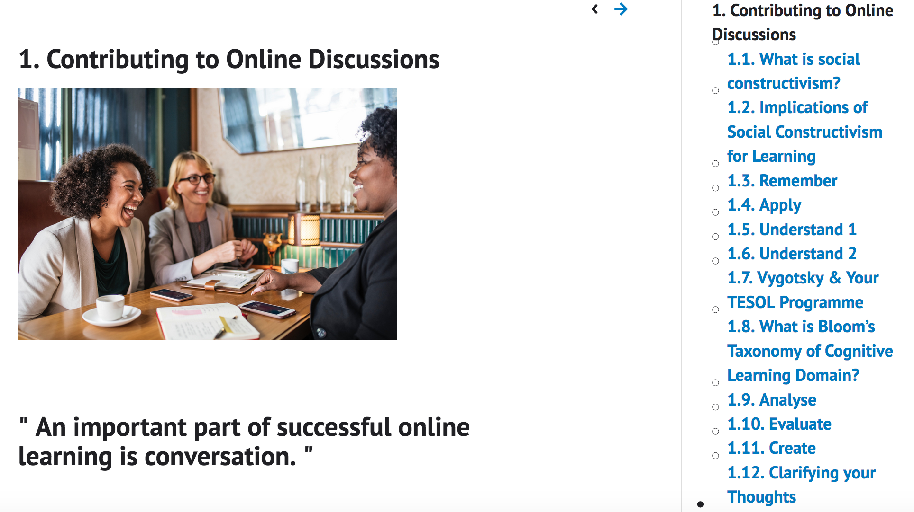
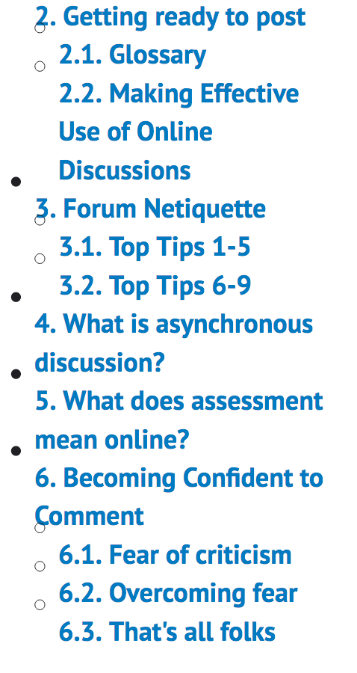
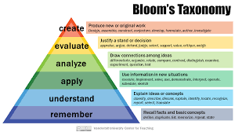
Building a community of learning online
Social
Cognitive
Compliment
Comment
Connection
Question
3CQ
Stewart-Mitchell (2016)

Slide 9
Developing a distinct online "voice" & personality
Encouraged students to explore different "voices" and self-expression
Multiple formats e.g. posters, PowerPoint slides, audio recordings, cartoons
Questions from our students
What's acceptable for me to think and to do?
How formal do I need to be?
Is it ok to reflect "in plain sight"?
Can you help me? (S-S; S-T)

Slide 10
Tentative conclusions
Students may in surprising ways
This Photo by Unknown author is licensed under CC BY-SA.
This Photo by Unknown author is licensed under CC BY-NC-ND.
This Photo by Unknown author is licensed under CC BY.

Slide 11
Reference list
Aithal, P.S. and Aithal, S. (2016). Impact of on-line education on higher education system. International Journal of Engineering Research and Modern Education, 1 (1), pp. 225-235.
Hodges, C., Moore, S., Lockee, B., Trust, T. and Bond, A. (2020).The Difference Between Emergency Remote Teaching and Online Learning. [online] Available at: https://er.educause.edu/articles/2020/3/the-difference-between-emergency-remote-teaching-and-online-learning [Accessed 21 April 2020].
Stewart-Mitchell, J. (n.d.). Blogging for students. [online] Available at: (http://bit.ly/1ORKsHr) http://elementarydigitalcitizenship.weebly.com/ [Accessed 22 February 2019].
Image: Teachnowaug15c2, n.d. Designing the physical environment of the classroom, including technology. [image online] Available at: http://teachnowaug15c2.pbworks.com/f/1443408663/phys8.jpg [Accessed 25 October 2017].

Slide 12
Moodle book references
Anderson, L. W., & Krathwohl, D. (Eds.). (2001). A taxonomy for learning, teaching, and assessing: A revision of Bloom's taxonomy of educational objectives. New York: Longman.
Garrison, D. R., & Akyol, Z. (2012). The community of inquiry theoretical framework. In M. G. Moore (Ed). Handbook of distance education (3rd edition), 104-120.
Siemens, G. (2004). Ch.19 Connectivism: A learning theory for the digital age in Foundations of Learning and Instructional Design Technology. Pressbooks. [online] https://lidtfoundations.pressbooks.com/chapter/connectivism-a-learning-theory-for-the-digital-age/
Vygotsky, L. (1978). Mind in Society. London: Harvard University Press.

Slide 13
Shift to emergency remote teaching
Alexander, B. (2020). Flipping the higher ed new normal: from synchronous to asynchronous education. [online] Available at: https://bryanalexander.org/education-and-technology/flipping-the-higher-ed-new-normal-from-synchronous-to-asynchronous-education/ [Accessed 29 April 2020].
Hodges, C., Moore, S., Lockee, B., Trust, T. and Bond, A. (2020).The Difference Between Emergency Remote Teaching and Online Learning. [online] Available at: https://er.educause.edu/articles/2020/3/the-difference-between-emergency-remote-teaching-and-online-learning [Accessed 21 April 2020].
Kukulska-Hulme, A., Beirne, E., Conole, G., Costello, E., Coughlan, T., Ferguson, R., FitzGerald, E., Gaved, M., Herodotou, C., Holmes, W., Mac Lochlainn, C., Nic Giolla Mhichíl, M., Rienties, B., Sargent, J., Scanlon, E., Sharples, M. and Whitelock, D. (2020). Innovating Pedagogy 2020: Open University Innovation Report 8. Milton Keynes: The Open University.

Slide 14
Shift to emergency remote teaching
Open University. (2020). Teaching at a Distance: Methods that Work. [online] Available at: http://www.open.ac.uk/blogs/innovating/?p=518
Veletsianos G., & Kimmons, R. 2020. What (Some) Students Are Saying about the Switch to Remote Teaching and Learning. [online] Available at: https://er.educause.edu/blogs/2020/4/what-some-students-are-saying-about-the-switch-to-remote-teaching-and-learning [Accessed 21 April 2020].

Slide 15
Shift to emergency remote teaching
Free access to Emerald's collection of relevant articles:
Navigating The Future of Learning: The Role of Smart Technologies
Introduction: The Disruptive Power of Online Education: Challenges, Opportunities, Responses
Online learning during post-earthquake school closures
Investigating different options in course delivery - traditional vs online: is there another option?
A minimalist design for distance learning

Slide 16
Useful reading on online learning & pedagogy
Angelo State University (n.d.) Effective Online Pedagogy. [online] Available at: https://www.angelo.edu/instructional-design/online-teaching/section_12.php [Accessed 21 April 2020].
Biasutti, M. (2011). The student experience of a collaborative e-learning university module. Computers & Education, 57(3), pp. 1865-1875.
Cheng, X., Wang, X., Huang, J., & Zarifis, A. (2016). An Experimental Study of Satisfaction Response: Evaluation of Online Collaborative Learning. The International Review of Research in Open and Distributed Learning, 17(1). https://doi.org/10.19173/irrodl.v17i1.2110.
De Freitas, S., & Conole, G. (2010). The influence of pervasive and integrative tools on learners’ experiences and expectations of study. In R. Sharpe, H. Beetham and S. De Freitas (Eds.), Rethinking learning for a digital age: How learners are shaping their own experiences (pp. 15–30). Abingdon, England: Routledge.
Elia, A., (2016). "What is a Classroom?"—Learning Environments, Library Collections, and the Internet in Theological Education, ATLA Summary of Proceedings, 70, pp.80-96. Available at: https://serials.atla.com/proceedings/index [Accessed 21 April 2020].

Slide 17
Useful reading on online learning & pedagogy
Elmahadi, I. and Osman, I. (2013). A Study of the Sudanese Students’ Use of Collaborative Tools within Moodle Learning Management System. IST-Africa Conference & Exhibition, [online] Available through: University of St Andrews Library website https://www.st-andrews.ac.uk/library/ [Accessed 22 March 2019].
Forster, S. (2017). How to shake up the discussion board in your online class. [online] Available at: http://mediashift.org/2016/07/how-to-shake-discussion-board-online-class/.
Geraniou, E & Crisan, C.. (2019). University students’ engagement with an asynchronous online course on digital technologies for mathematical learning. [online] Available through https://www.researchgate.net [Accessed 03 December 2019].
Gordillo, J.J.T., & Rodriguez, J.H.P. (2005). Studying collaborative learning in online discussion forums. ICTE in Regional Development: 2005 Annual Proceedings. 2005, p118-121.
Gunawardena, C. N., & Zittle, F. J. (1997). Social presence as a predictor of satisfaction within a computer-mediated conferencing environment. American Journal of Distance Education, 11(3), pp. 8-26.

Slide 18
Useful reading on online learning & pedagogy
Morris, S.M. & Stommel, J. (2018). An urgency of teachers: The work of critical digital pedagogy. [online – open access by donation] Available at: https://urgencyofteachers.com/
Rezaei, M., Osam, U. & Manzari, E. (2015). Post-graduate Students' Perception of Using Moodle in a Teacher Education Course: A Focus on Pros, Cons and the Role of Technological Pedagogical Content Knowledge (TPACK). [pdf online] Available through https://www.researchgate.net [Accessed 03 December 2019].
Stanca, L. and Felea, C. (2016). Student Engagement Pattern in Wiki- and Moodle-Based Learning Environments – A Case Study on Romania. Available at: https://link.springer.com/chapter/10.1007/978-981-287-868-7_19 [Accessed 21 March 2019].
Swan, K., Shen, J., & Hiltz, S. R. (2006). Assessment and collaboration in online learning. Journal of Asynchronous Learning Networks, 10(1), pp. 45-62.
TPACK (n.d.). What is TPACK? [online] Available at: http://www.tpack.org/ [Accessed 02 December 2019].

Slide 19
Inspiration & accessible design
Online Learning Consortium* (n.d.). Excellence and Innovation in Online Teaching Award. [online] Available at: https://onlinelearningconsortium.org/about/olc-awards/excellence-online-teaching/ [Accessed 21 April 2020].
*OLC is a collaborative community of higher education leaders and innovators, dedicated to advancing quality digital teaching and learning experiences designed to reach and engage the modern learner – anyone, anywhere, anytime.
----------------------------
Gov.uk (2016). Dos and don'ts on designing for accessibility. [online] Available at: https://accessibility.blog.gov.uk/2016/09/02/dos-and-donts-on-designing-for-accessibility/ [Accessed 29 April].

