Slide 1
Perceptions of colour-coding in EAP assessment and feedback
EAP in the North, The University of Manchester
caitlincoyle@glasgowkelvin.ac.uk

Slide 2
Outline
Rationale and Context
Methodology
Findings
Conclusions
Limitations
References

Slide 3
Rationale
1. Providing ‘appropriate’ feedback on assessment →
key competency of the EAP practitioner (BALEAP, 2014)

Slide 4
Rationale
2. There are studies (Elwood & Bode, 2014; Hamid, Nasri & Ghazali, 2018) about colour-coding in feedback in EFL but little in EAP
Its effectiveness as a form of ‘indirect’ feedback

Slide 5
Rationale
There are studies (Elwood & Bode, 2014; Hamid, Nasri & Ghazali, 2018) about colour-coding in feedback in EFL but little in EAP
Why?
Perceptions→
students and teachers

Slide 6
Rationale
3. ‘Levels of textual intervention’ and the usefulness of in-text comments (Khuder & Petrić, 2020)

Slide 7
Context
Last five weeks of University of Glasgow’s 2021 pre­-sessional course
Online ESAP course
In-text comments and a holistic comment were still expected to be provided

Slide 8
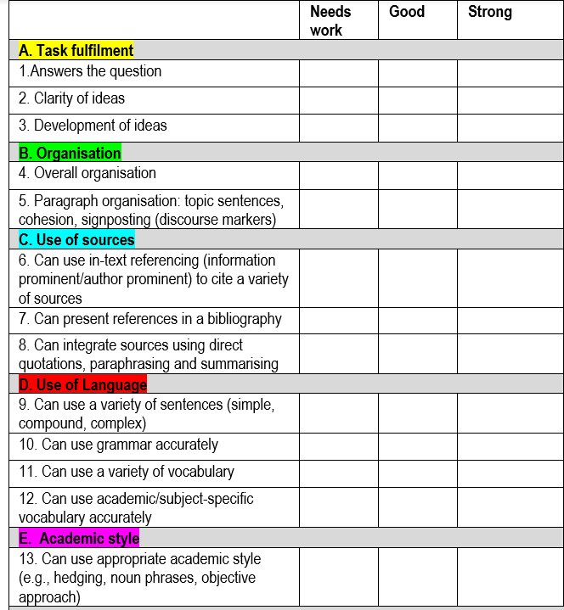
Example of colour-coded marking criteria (blank marking criteria: University of Glasgow, 2021)

Slide 9
Possible example of student’s work

Slide 10
Methodology
Anonymous Microsoft Forms questionnaires
→ 16 students
→ 5 teachers

Slide 11
Methodology
1. How useful was the colour-coding of the marking criteria and specific parts of your extended essay in helping you understand the areas for improvement? (Likert scale question)
2. Can you explain your answers to question 1?
3. Can you think of any specific advantages in the use of colour-coding in assessment and feedback?
4. Can you think of any specific disadvantages in the use of colour-coding in assessment and feedback?
5. Do you have any other comments?

Slide 12
Findings

Slide 13
Findings: Very useful/somewhat useful
Student 2: ‘It is easy to focus the problem which I need to revise’
Student 4: ‘It is more clear to make sure what kind of mistakes you have made’
Student 15: ‘Colour-coding is useful in making differences of notes, I can know the criteria is about word, citation, logic or etc. easily and clearly’

Slide 14
Findings: Not very useful
Student 6: ‘I think it helped save me a lot of time’

Slide 15
Any advantages? (Student perceptions)
44% specifically mentioned the word ‘clear’/ ‘clearly’
Time-saving
Could categorise their errors against the marking criteria and see the types of errors

Slide 16
One student’s perspective
Student 7: ‘First, you can more quickly correspond to the problem through the table corresponding to the color and problem. Secondly, you can more clearly distinguish different types of problems through different colors. Third, it saves time for problem classification to a great extent and helps me reflect’

Slide 17
Any advantages? (Teacher perceptions)
‘More explicit’/‘less ambiguous’ than words
Simplifying feedback for markers
Help with error categorisation/error awareness

Slide 18
One teacher’s perspective
Teacher 1: ‘Would potentially make it easier for students to make connections between specific tutor feedback comments and the category in the feedback sheet or descriptor. Students are often confused by the many words/synonyms/classifying terms used by tutors and course materials, for instance, cohesion, linking, making connections, cohesive devices - so if there was a colour-coded system for this particular area, perhaps students could see that these terms were more or less referring to the same thing’

Slide 19
Any disadvantages? (Student perceptions)
Student 3: ‘ I think in some situations it is not flexible’
Student 12: ‘I think some colors are not suit…..I think red coding is ugly and making me feel unhappy’
Student 14: ‘It may make the article look messy overall, and if there are too many codings, it will even confuse thinking’
Student 10: ‘…there may be some problems for color blind students (they can't distinguish some colors well)’

Slide 20
Any disadvantages? (Teacher perceptions)
Problematic for students with colour-processing disorders
Too simplistic if used alone
Potential to raise anxiety (esp. neurodivergent students)
If certain criteria are more crucial than others, this distinction may be loss

Slide 21
One teacher’s perspective
Teacher 2: ‘…There may be a perception that the use of colour detracts from the formality of the feedback and some students may feel it undermines their ideal self (Dornyei)’

Slide 22
Any other comments?
Student 4: ‘Actually, it needs teachers' more work, but really helpful for students’
Teacher 4: ‘The system may simplify feedback and responses to it once students and staff are used to it and understand the priority of importance. This could diminish inordinate amounts of time spent on relatively unimportant areas. If no other feedback is provided on a detailed basis, then students have more autonomous responsibility to take for erroneous areas’

Slide 23
My own thoughts
Yes, it can be time-consuming but so are in-text comments
It made easier to write a holistic comment at the end (e.g. ‘more pink highlighted’→ ‘focus on academic style’)
Certain things were harder to highlight (organisation on a macro-level; overlapping categories)
Focus only on errors?
Another colleague mentioned cost of printing if some students felt necessary to print

Slide 24
Conclusions
Overall, students reported that it a useful form of feedback
Its main advantages for teachers and students appeared to be that it was quite clear and helped with error recognition
Its disadvantages included that it may present problems with specific types of students (more guidance and research needed) and loss in distinction of importance between categories

Slide 25
Conclusions
If this form of feedback is used, discussion with students prior to its use is recommended so that:
it is suitable for learners’ accessibility needs
the marking criteria’s categories are clear as well as their importance
ideally used alongside a holistic comment

Slide 26
Limitations
I was the only teacher involved in the research
The researcher the same person as the marker
I still had to give in-text comments (but gave fewer)
Limited teacher feedback

Slide 27
References
BALEAP (2014). TEAP Scheme Handbook. https://www.baleap.org/wp-content/uploads/2016/04/TEAP-Scheme-Handbook-2014.pdf
Elwood, J. A., & Bode, J. (2014). Student preferences vis-à-vis teacher feedback in university EFL writing classes in Japan. System (Linköping), 42, 333-343. https://doi.org/10.1016/j.system.2013.12.023
Hamid, H. A., Nasri N. F., & Ghazali, N. (2018). Colours as a form of corrective feedback in EFL learners’ writing. Journal of Language Studies, 18(4), 106-123. http://doi.org/10.17576/gema-2018-1804-08
Khuder, B. & Petrić, B. (2020). Academic socialisation through collaboration: Textual interventions in supporting exiled scholars’academic literacies development, Education and Conflict Review, 3, 24–28.
University of Glasgow (2021). Extended Essay Marking Criteria.

Slide 28
Thank you for listening

