Slide 1
Quicklinks + Quickmarks = double quick feedback
Benet Vincent
Hilary Nesi
Daniel Quinn

Slide 2
Outline
The concept of Quicklinks
Some examples of links
The ‘encyclopedia’ of links
Combining Quicklinks with Turnitin QuickMarks

Slide 3
https://bawequicklinks.coventry.domains
Links to appropriate usage to insert into student work

Slide 4
What are Quicklinks?
For example:
Ellis (2002) supports that formal grammar teaching has a delayed effect on language teaching.
Possibly not a frequent error in itself
But example of common type of error
Also not obvious how a student could check whether they were right

Slide 5
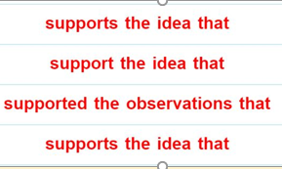
What are Quicklinks?
The student who writes…
Ellis (2002) supports that formal grammar teaching has a delayed effect on language teaching.
…can be directed to https://ske.li/supportthenthat to understand their error
Or, taking it further…
These examples show the need for a noun (e.g. ‘idea’) between ‘support’ and ‘that’.

Slide 6
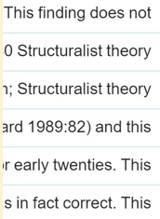
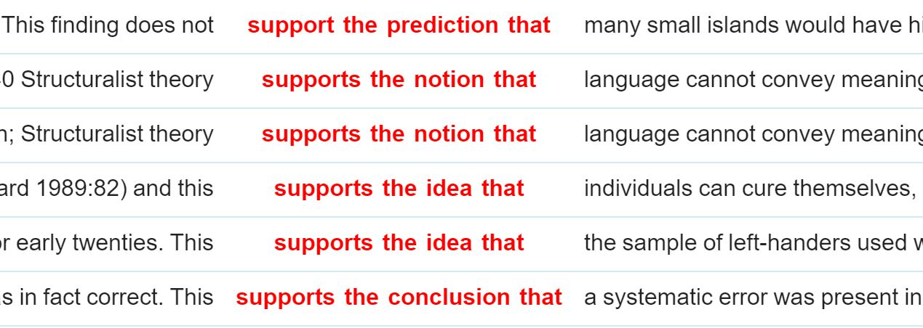
Giving quick feedback (‘Quicklinks’)
The student who writes…
Ellis (2002) supports that formal grammar teaching has a delayed effect on language teaching.
…can go to https://ske.li/evidence_support to see this construction doesn’t usually have human subjects:
other teachers/lecturers who spot a similar error could use the link in a similar way, if they have access to it…
Notes:
Approach is based on/ inspired by DDL: inductive method encouraging students to notice patterns of use in authentic language- corpora / corpus interfaces are the means of presenting this language / these patterns
But requires a cognitive ‘jump’ from students to connect data/patterns to their own language issues…

Slide 7
Where are the examples from?
All taken from the British Academic Written English (BAWE) corpus
Contains c.2700 ‘good’ student assignments (about 6.5m words)
Range of disciplines, levels, genres
Open access via Sketch Engine

Slide 8
The Quicklink Directory
https://bawequicklinks.coventry.domains/directory-of-hyperlinks/

Slide 9
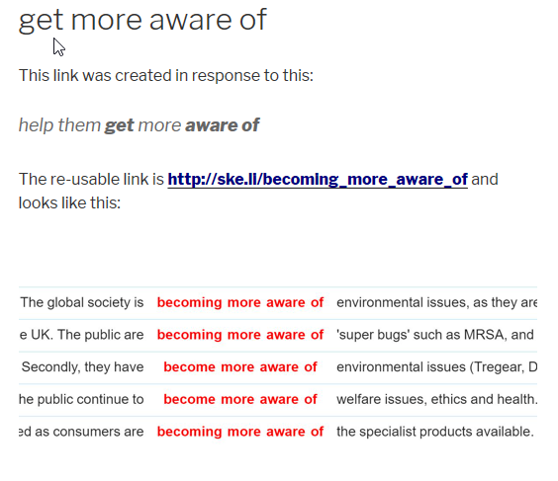
Entries in the directory
look like this
Users can reuse links without knowing how they were created

Slide 10
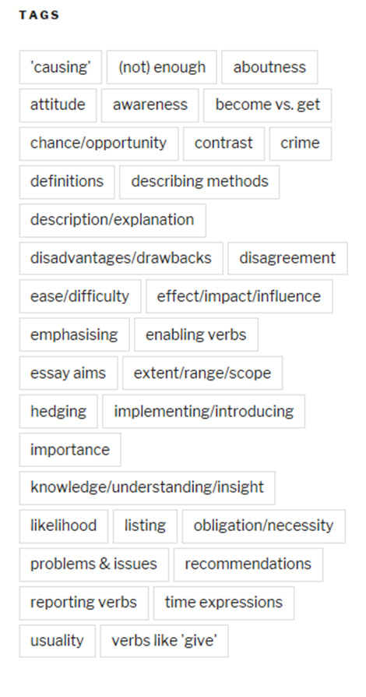
Finding the link
you want
Or by tag:
Use alphabetical list:
There are c. 100 links at present so you may not find what you want. Let us know any requests…
Search for specific word:

Slide 11
Some considerations
You need to be able to find the right link quickly
How should we group links to help this happen?
Specific examples are best for correcting particular mistakes
More generic examples address a wider range of issues and are more likely to be reused
Are students likely to follow the link? What would they then do?

Slide 12
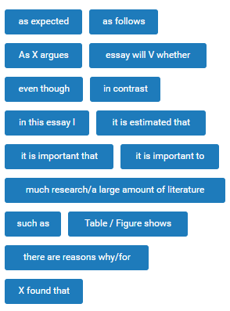
New development: QuickMarks set
Idea to collect some of the most frequent / annoying mistakes we see:
NB this approach is not suited to certain types of mistakes (basic grammar, spelling etc.)
You may recognise some of these…

Slide 13
https://bawequicklinks.coventry.domains/quicklinks-on-turnitin/
New development: QuickMarks set
Links to recent publications
Links the QuickMarks set, resources for introducing it to students and tips on editing the set
Screencast showing how the set can be used

Slide 14
Using links in practice
We’ve made a short video to show how this works:

Slide 15
Ways the links might be used
Provide a link to examples of acceptable usage
Provide two links for comparison
Provide link(s) with advice – e.g. “you need a noun (e.g. idea) between support and that”.
Provide link(s) with a prompt to encourage reflection (“what kind of word follows support? What tense is usually used?”)
Provide link(s) and encourage further exploration of Sketch Engine (materials to follow soon)

Slide 16
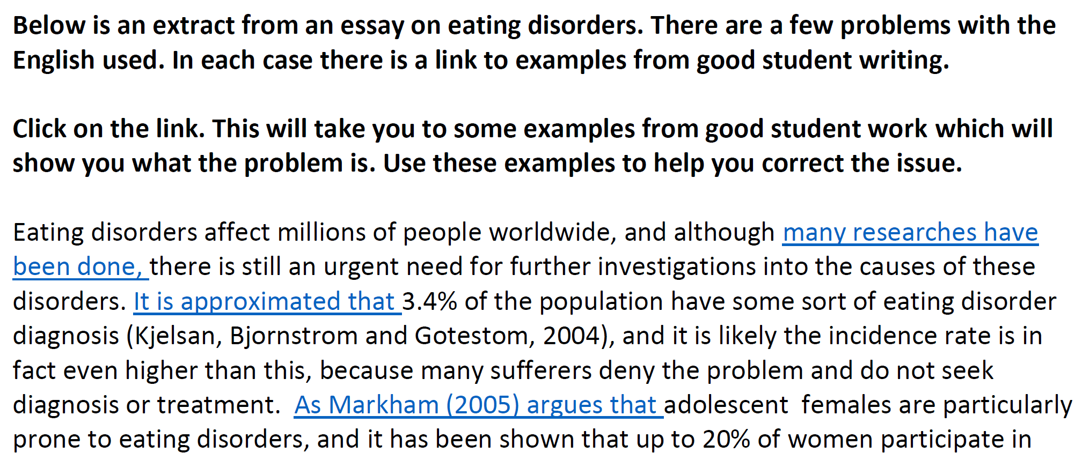
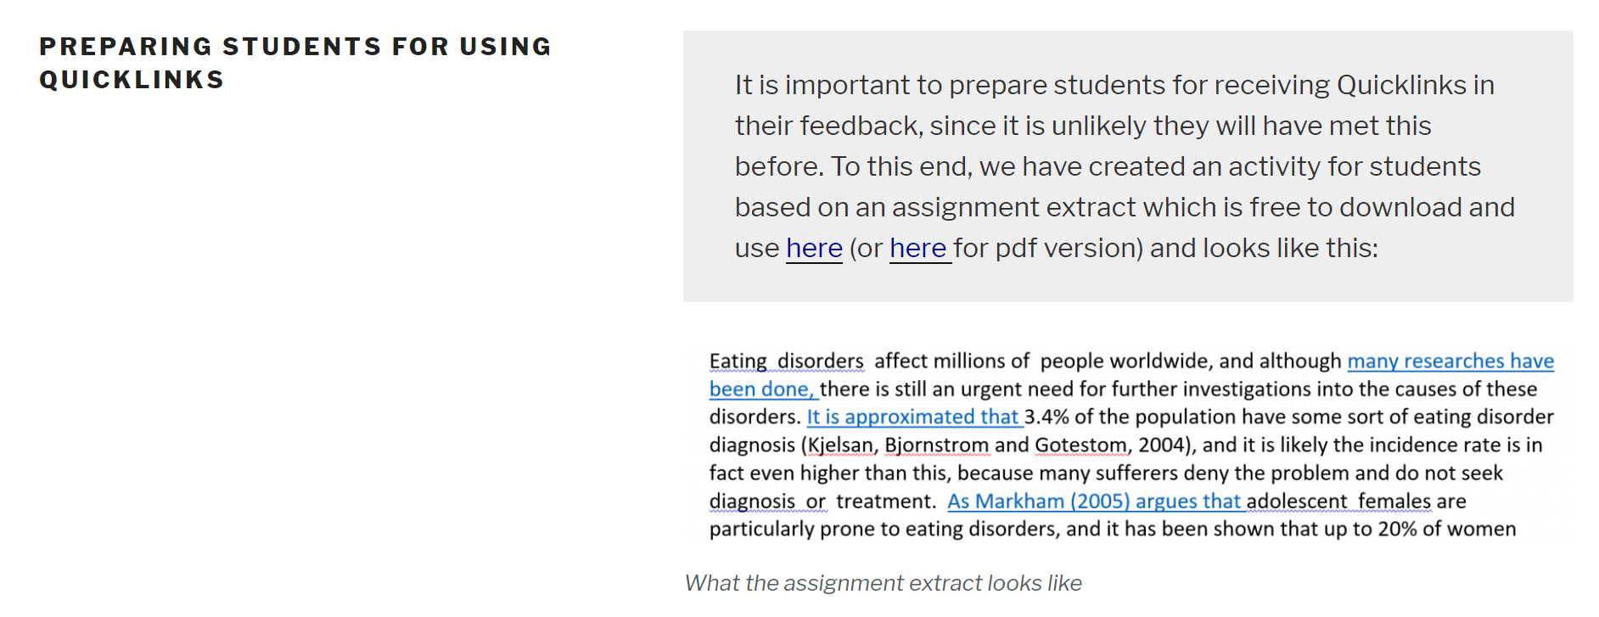
Introducing students to Quicklinks https://bawequicklinks.coventry.domains/quicklinks-on-turnitin/introducing-students/
Students not necessarily familiar with corpus output, so need some introduction
We’re working on more learner materials to supplement Peter Crosthwaite’s course (University of Queensland) – see here

Slide 17
Other thoughts / questions
Do you think you might use these links? What might encourage you to?
How many might you use per assignment?
We welcome other suggestions, e.g. for
new links
adaptations to existing links
guides for teachers
If you do use the QuickMarks set for giving feedback please consider completing our online survey

Slide 18
Thanks for participating
Any questions?
Benet Vincent ab6667@coventry.ac.uk
Hilary Nesi aa3861@coventry.ac.uk
https://bawequicklinks.coventry.domains/

