Slide 1
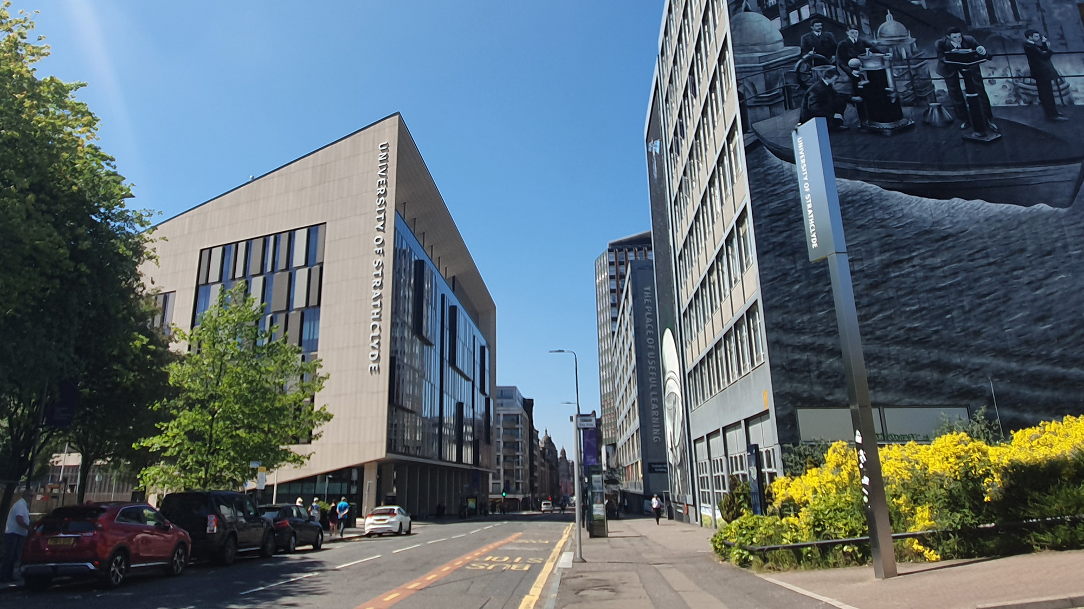
THE USE OF AN ASSESSED ASYNCHRONOUS ONLINE DISCUSSION FORUM TO HELP FOSTER DEEP LEARNING
Fiona Nimmo (Programme Co-ordinator)
English Language Teaching Unit Email: fiona.nimmo@strath.ac.uk
X THE PLACE OF USEFUL LEARNING

Slide 2
PURPOSE OF THIS TALK
Findings from this study, and a pilot study, suggest the use of an assessed asynchronous online discussion forum (AOD) can help promote higher-order cognitive skills (Mazur, 2014), reflection (Seethamraju, 2014), and enhanced communication (Sun et al., 2017), all of which are key transferable graduate attributes and employability skills (Advance Higher Education, 2020).

Slide 3
THE INTERNATIONAL LEADERSHIP DEVELOPMENT PROGRAMME (ILD)
ILD = 20-credit core subject for all International UG students at the Strathclyde Business School (SBS) learners experienced difficulty in the ability to critically analyse text and articulate ideas and theories.
The English Language Teaching Unit (ELT) component accounts for 5% of the overall ILD credit, and utilises SBS materials ‘Flipped classroom’ (The Khan Academy, 2020).
There were eight students involved in this study.

Slide 4
This case study uses socio-cultural theory as a lens for evaluating the use of the AOD as a preparatory activity to support learning (Piaget, 1952; Chomsky, 1957; Vygotsky, 1978).
Collaboration, knowledge construction, decision making, critical thinking, & problem solving (Goggins & Xing, 2016).
It is ‘through online discussion’ that learners are able to ‘employ deeper, higher-order thinking that can result in more engaged learning’ (Bernstein & Isaac, 2018:3).

Slide 5
DEEP LEARNING
‘The cognitive skills’ and ‘academic knowledge’ required to enable students to function effectively in the UK HE context and beyond. Skills include critical thinking, problem solving, communication, collaboration and learning to learn’ (Advance Higher Education, 2020).

Slide 6
3 Data Sources
Semester 2 AOD threads - analysed using Bernstein and Isaac’s (2018) Components of critical thinking.
An end of programme evaluative questionnaire (13 Qs) employing a 4-point Likert scale (strongly agree to strongly disagree) to evaluate perceived effectiveness of the use of an assessed AOD to help foster deep learning.
A final non-assessed end of programme evaluative AOD inviting students to discuss the extent to which the AOD helped support learning in preparation for the ELT and SBS face-to-face sessions.

Slide 7
AOD INSTRUCTIONS
1. Post at least one comment based on understanding/opinion of source material (100-150 words).
2. Write a response to comments made by at least two others (100-150 words).
3. Add further comments /responses as appropriate.
4. Read more widely than SBS suggested source material.
5. Reference all sources appropriately.
Adapted from The University of Calgary Teaching and Learning Centre (2018).

Slide 8
5 (ELT 7) | Posts in discussions indicate in-depth understanding of the task. Readily offers interpretations of source material and supports opinions with evidence. Comments on other posts and responds appropriately to comments on own posts. Information and ideas are expressed logically, clearly, and concisely. Handles complex and detailed argumentation well. Uses a wide range of vocabulary with only occasional inaccuracies in word choice and/or collocation. Spelling and grammatical errors are rare.
4 ELT 6.0 | Posts in discussion indicate adequate knowledge of the source material with occasional lapses in relevance, logic and/or detail. Supports some opinions with evidence. Generally, offers comment on other posts and/or responds to comments on own posts. Presents information and ideas effectively with only occasional inaccuracies. Uses a sufficient range of vocabulary but there may be some inaccuracies in word choice and/or collocation. Occasional spelling and grammatical errors.
3 ELT 5.0 | Posts suggest very little understanding of the source material. Does not offer opinion and/or fails to support opinion with appropriate evidence. Rarely comments on other posts and/or fails to respond to comments on own work. Has very little control of organisational features and there is no clear progression in the response. Uses only a limited range of vocabulary to satisfy the task. Frequent spelling and grammatical errors may cause strain for the reader.
2 ELT 4.0 | Posts are rare and do not indicate understanding of the source material. Does not comment on other posts or reply to comments on own posts. Fails to communicate any real message. Does not organise ideas logically. Attempts only basic vocabulary, which may be inappropriate, inaccurate and/or repetitive. Frequent Spelling and grammatical errors cause difficulty for the reader and may distort the overall meaning.
1 (Fail) | Student did not use the discussion forum.

Slide 9
Coding System & Tasks
Components of Critical Thinking:
Problem identification
Clarifying question
Logic of argument
Evidence/supportive information
Synthesis of ideas
References to readings
Problem solving
(Bernstein and Isaac, 2018)
Seminar discussions
Poster presentations
Role play
Problem solving tasks
Analysing & annotating sources
Developing new business ideas and initiatives to support the SD goals
Reflecting on the learning process
Peer review
Six AOD threads:
Audio visual material – Negotiation lecture (AOD1)
Problem solving tasks - Case studies (AOD2, AOD3, AOD4, AOD5)
Written material – 3 Social Marketing journal articles (AOD6)

Slide 10
AOD1 = Audio Visual (Negotiation lecture)
AOD2, AOD3, AOD4, AOD5 = Problem Solving (case studies)
AOD6 = Written (3 Social Marketing journal articles)

Slide 11
AOD1: Confusion over ‘Colombo effect’ as referenced in a video on negotiation techniques.
2 components: Clarifying question (refuting bias with a particular emphasis on personal interpretation of content), reference to readings.
What you have suggested is an insightful opinion, albeit wrong. I searched on the internet and found a definition which to some extent could be trustworthy. Please take a look at the link if you’d like further information https://www.urbandictionary.com/define.php?term=columbo
Colombo is a TV show detective who is known by the same name who at the end of his investigations/interrogations adds ‘one more thing’ – and usually the one more thing is the most surprising. This explanation sounds more reasonable and maybe we can discuss this more deeply in class?
.

Slide 12
AOD1 contd.
Final explanation of the ‘Colombo effect’ in a negotiation context
2 components: Clarifying question (accurate paraphrase), synthesis of ideas (clearly connecting concepts).
*Negotiation is not a competitive game. We cannot have a mindset that we have to win. We need to think carefully about our brands, which means we have to protect our reputation. This is a key point to building lasting relationships and durable agreements. We have to have a positive mindset, trust our partners, and be accountable.
* Clarifying question (accurate paraphrase).

Slide 13
AOD3: Student interpretation of the entire thread written as a final summary in preparation for an in-class seminar discussion. 1 component: clarifying content (accurate paraphrase).
Lastly, I have go through all your forums topics, including advertisement, advocation, data analysis, company's annual report, market research, cutting-edge technology, the main profitable products, the scale about the company, cooperation with big company, and the website. In summary, I divided them into 4 parts:
The background research, for example, what level of technology is high enough.
The future of the industry is it sustainable or profitable, what is the position of this industry.
The company itself, we currently know nothing about its stuff, its operation mode, the scale and technology.
Last, which kind of data is available, which is not. I think if we solve all the parts, we can face any problem we might meet with.
And of course, I welcome any supplement.

Slide 14
AOD5: Students invited to discuss any outstanding queries around a case study on Ecotourism.
5 components: Problem identification (the waste disposal and buy in for the project), clarifying question (providing a dichotomy), logic of argument (sequence and flow), synthesis of ideas (building on others’ ideas), problem solving.
*For locals who are self-sufficient but want to increase their income, ecotourism could be a good choice. If ecotourism is developed, pollution is inevitable. A well established channel for dealing with garbage is crucial. The question could be asked whether the tribe has channels for waste disposal? In addition, if some locals are unwilling to participate, in order to reduce interference to their lives, is there any other area for development? Furthermore, are locals willing to share their culture with foreign visitors?
*Logic of argument (sequence and flow).

Slide 15
AOD6 demonstrated the highest level of Bernstein and Isaac’s (2018) Components of Critical Thinking. In the following example there are 6 components. The only component missing is problem solving (this had not been a task requirement on this occasion).
6 components: Problem identification (weaknesses of social marketing linked to historical phenomenon), clarifying question (clarifying content with a paraphrase), logic of argument (sequence, flow, and clear valid assumptions), evidence/supportive information (clear connection to topic and relevant examples – identifying a gap), synthesis of ideas (biuilding on others’ ideas), references to readings (citing to make a point).

Slide 16
*Instead of potential risk, I suppose what you really wanted to imply was the underlying weaknesses of those projects conducted by the foreign NGOs.
As mentioned in the second half of the report, the absence of a solid monitoring and evaluation system was a weakness in many projects. What is more, the quality of implementation, elaborated by the example of exchanging hunting guns is also worth examining. Although there is ample of evidence to suggest that most of the tourism projects meet the 6 social marketing benchmarks, resulting in a promising future for both the place of interests and the local residents, the host; and the tourists, the guests, from elsewhere, serious problems might be caused due to the lack of scrutiny and pitfalls in the terms enacted by the organizers.
In this sense, I think the perspective of analysis of the first article, the Social Marketing and Tourism: What is the Evidence is pretty critical and rigorous, since the author have not only provided the merits of introducing the idea of social marketing to tourism, but also point out the current situation is not flawless.
* Problem identification (weaknesses of social marketing linked to historical phenomenon), clarifying question (clarifying content with a paraphrase).

Slide 17
End of Programme Evaluative Questionnaire - Anonymous
N.B. Statement 8 is a bit of an anomaly here. 5 of the 8 students returned a disagree response. So I took the opportunity in one-to-one tutorial sessions to try to understand this further. I told the students I only wanted to ascertain what they had understood from the statement and not what their response to it was. Interestingly, and perhaps not surprisingly given the wording, more than half the students had misunderstood - perceiving the statement to refer to meaningful forum discussion as opposed to meaningful spoken language in class. As statement 11 also refers to participation in class, I excluded statement 8 responses from my final data analysis.

Slide 18
Evaluative Questionnaire & Comment Box Responses
7 of the 8 ILD students (87.5%) responded favourably (strongly agree or agree) to the AOD as a tool to help foster deep learning, with only one response carrying a disagree return (12.5%).
100% agreed the AOD helped them become more critical of problems and issues discussed citing improvement in e.g., problem-solving, logical thinking, reflection, ability to organize and analyse information from different perspectives.
Aside from perceived improved confidence in class-based discussion (62.5%) and writing ability (87%), students cited cooperation, negotiation, brainstorming, and teamwork as key transferable skills.
87.5% were (still) in favour of having marks assigned for the AOD citing ‘motivating’ factors as their rationale, with only one response carrying a disagree return (12.5%).

Slide 19
100% noted that they were happy to offer, and receive, constructive criticism and feedback, whilst readily taking opportunities within the forum threads to ‘refute the bias’ and ‘present a dichotomy’ (Bernstein & Issac, 2018).
100% commented they had a deeper understanding of the topics as a result of formulating their own responses online, with one student noting that expressing (myself) through writing before the face-to-face class makes me more comfortable and more confident in class which also improves motivation and participation in the discussions.
100% noted they had learned additional concepts and/or main ideas through the process of reading other members’ posts, with one student highlighting the importance of being patient – to understand others’ opinions, and another highlighting the importance of respecting others’ views.

Slide 20
Evaluative AOD Posts: Discuss the extent to which the forum helped support learning in preparation for the ELT & SBS face-to-face sessions.
73% of the posts referred to how useful the forum had been e.g., beneficial, a good platform to build confidence, plays an important role in the preparation of reading, brainstorming, note-taking, writing, serves as a bridge between reading and understanding knowledge, gives opportunities to practice English, helps me prepare for my face-to-face classes, helps me leave my comfort zone, gives us time and room to think …(allowing) a high-quality answer, helps us think deeply .. instead of (using) surface usages.
50% of the posts referred to additional concepts/ideas learned through reading other posts particularly those that were well-written. Other comments included being inspired, learning new concepts and ideas that might otherwise have been overlooked, encountering differing opinions, encouraging me to think (more) deeply …helping to eliminate my prejudice, reflecting appropriately, organising thoughts, writing concisely and to the point as (we) had to keep within the word count.

Slide 21
Conclusions
The findings suggest the use of an assessed AOD can help promote higher-order cognitive skills (Mazur, 2014), reflection (Seethamraju, 2014), and enhanced communication (Sun et al., 2017); areas highlighted by SBS as problematic for their International UG learners.
When learners are involved in the decision-making process, and the learning environment is supportive and inclusive, they not only survive but thrive (Healey et al., 2014; Carless, 2015; Sambell, 2016; Ho, 2020).
SBS have now promoted the AOD in their published marketing materials as an effective and supportive learning tool and Unique Selling Point (USP).

Slide 22
Advance Higher Education (2020). Retrieved April 2020, from https://www.heacademy.ac.uk/
Bernstein, A. G. & Issac, C. (2018). Critical Thinking Criteria for Evaluating Online Discussion. International Journal for the Scholarship of Teaching and Learning, 12(2), 1-8.
Carless, D. (2015). Exploring learning-oriented assessment processes. Higher Education, 69(6), 963-976.
Chomsky, N. (1957). Syntactic structures. The Hague: Mouton.
Goggins, S, & Xing, W. (2016). Building models explaining student participation behavior in asynchronous online discussion. Computers and Education, 94, 241-251.
Healey, M., Flint, A. & Harrington, K. (2014). Engagement through students as partners in learning and teaching in higher education cited in The Higher Education Academy. Retrieved April 2020, from https://www.heacademy.ac.uk/sites/default/files/resources/engagement_through_par tnership.pdf
Ho, S. (2020) Culture and Learning: Confucian Heritage Learners, Social-Oriented Achievement, and Innovative Pedagogies cited in Sanger C. & Gleason, N. (Eds) (2020). Diversity and Inclusion in Global Higher Education. Palgrave Macmillan, Singapore.
Mazur, E. (2014). Peer Instruction: A User’s Manual. Essex: Pearson Education Limited.

Slide 23
Niemczyk, E. (2019). Glocal Education in Practice: Teaching, Researching, and Citizenship (11–18). The Bulgarian Comparative Education Society.
Piaget, J. (1952). The origins of intelligence in children. New York: International University Press.
Sambell, K. (2016) Assessment and feedback in higher education: considerable room for improvement? Student Engagement in Higher Education, 1(1), 12-14.
Seethamraju, R. (2014). Effectiveness of Using Online Discussion Forum for Case Study Analysis. Retrieved January 2020, from https://www.researchgate.net/publication/271845597
Sun, D., Looi, C. K. & Xie, W. (2017). Learning with collaborative inquiry: A science learning environment for secondary students. Technology, Pedagogy and Education, 26, 241-263.
The Khan Academy (2020). Introduction to Blended Learning. Retrieved March 2020, from https://www.khanacademy.org/partner-content/ssf-cci/sscc-intro-blended-learning.
The University of Calgary Teaching & Learning Centre (2018). Inquiry Through Blended Learning: Evaluating or Marking Online Discussion Participation. Retrieved Dec 2019, from http://tlc.ucalgary.ca/
Vygotsky, L. S. (1978). Mind in Society. Cambridge: Harvard University Press.

