Slide 1
Exploring students’ affective responses to activities in the online EAP classroom
rachel.heasley@manchester.ac.uk

Slide 2
Outline
Context
The mini-research project
Summary of student responses and possible implications for teaching EAP online/dual delivery

Slide 3
Context
Difficulty maintaining and measuring student engagement in an online world

Slide 4
What do we mean by ‘engagement’?
Affective
Cognitive
Behavioural
(Fredricks et al., 2004)

Slide 5
What do we mean by ‘engagement’?
Affective
Cognitive
Behavioural
(Fredricks et al., 2004)

Slide 6
What do we mean by ‘engagement’?
“…[affective] engagement is considered important to measure at the K12 level but loses stature to researchers as students mature. Yet emotions do not cease to be critical to learning as the learner enters the university.”
(Henrie et al., 2015: 44)
Affective
Cognitive
Behavioural

Slide 7
Action research: Measuring affective engagement in the online EAP classroom
Research question: What do EAP students find enjoyable and/or useful in the online EAP classroom, in terms of…
materials
interaction patterns
and how they receive feedback?

Slide 8
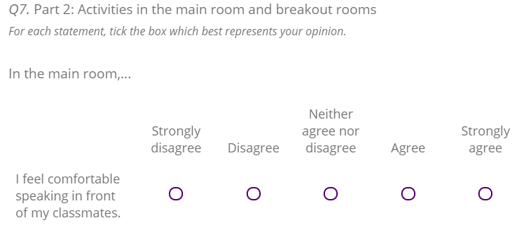
The questionnaire and participants
49 participants: Foundation year (n=17) and Pre-sessional EAP (n=32) students
27 had studied English online prior to UoM 11 had not (11 not disclosed)
Predominantly Likert scale response to statements, with optional follow-up comments

Slide 9
Responses: materials
All students agreed that “using shared documents (e.g. google docs/ OneDrive) is easy and useful for my learning”.
But, this was mid-course. Additional comments suggest responses might have been different at start of course:
“At first, I was quite confused. Now, I am pretty good at it.” (S7)
“It's difficult for me to use the first time, but it's fine then.” (S1)

Slide 10
Responses: interactions

Slide 11
Responses: interactions
70% of those who had studied online before felt comfortable speaking in the main room, compared to 57% of those relatively new to online English lessons.

Slide 12
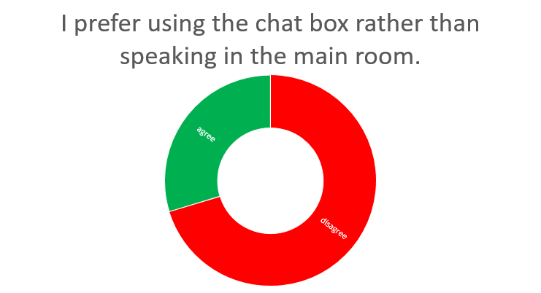
Responses: interactions

Slide 13
Responses: interactions in Breakout rooms
Students indicated a preference for working with a maximum of three other students in a BOR.

Slide 14
“I think breakout rooms with less people is a good way to help those who are too shy to talk in front of many people.” (S5)
“with more people it is more difficult to know when we should speak” (S1)

Slide 15
Responses: interactions in Breakout rooms
Students indicated a preference for working with different people in BOR activities during a lesson.

Slide 16
Responses: interactions Building community
Vast majority viewed developing friendships with classmates as important (43 of 49) but only 37 felt they had developed friendships
“Maybe during online courses, most of the time I only communicate things relate to course with others” (S3)

Slide 17
Responses: interactions Video cameras
57% said they prefer to have their camera on during lessons.
65% said they prefer other people to have their camera on during lessons.

Slide 18
Responses: feedback methods

Slide 19
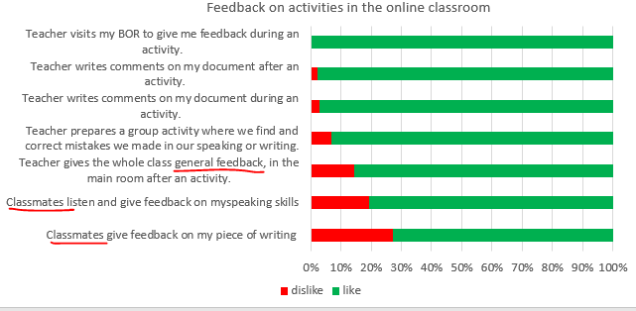
Responses: feedback methods

Slide 20
Possible implications for planning and teaching EAP online
Using shared docs –more learner training may initially be needed
Building community – students see value in developing friendships. More opportunities for non-lesson-related interaction may be beneficial
BORS – Smaller (2-4) and varied groupings seem preferable
Feedback – BOR visits and any feedback from teacher generally positively received But more learner training may be needed in peer-feedback

Slide 21
References
Fredricks, J. A., Blumenfeld, P. C., & Paris, A. H. (2004). ‘School Engagement: Potential of the Concept, State of the Evidence’. Review of Educational Research, 74(1), 59-109. http://dx.doi.org/10.3102/00346543074001059
Henrie, C. R., Halverson L. R., & Graham, C. R. (2015). Measuring student engagement in technology-mediated learning: a review. Computers & Education, 90, 36(53). http://dx.doi.org/10.1016/j.compedu.2015.09.005

